Slide 1
Hospital stay duration
Miguel Zavala – ahmad salama – arman azhand

Slide 2
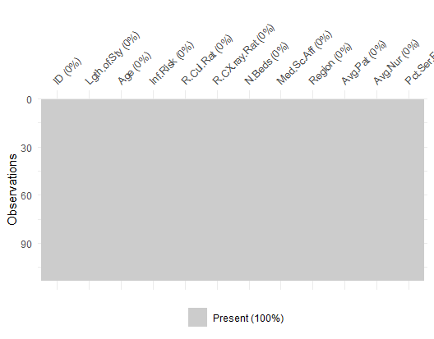
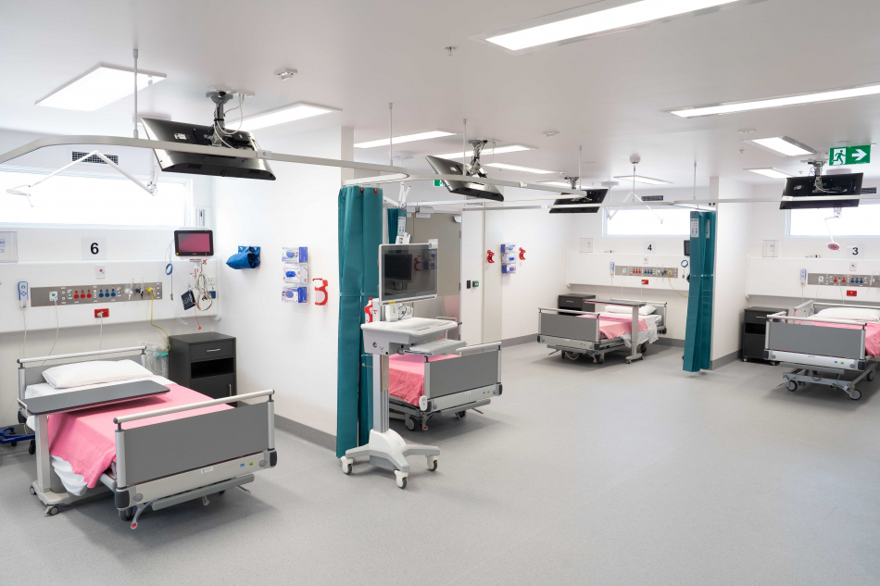
What is our data?
113 observations
13 variables:
1 identifier (not used)
1 response variable
8 continuous variables (numeric)
2 categorical variables
No missing values for any observation!
Hospital ID | Identifier variable
Length of Stay | Average length of stay (in days)
Age | Average age of patients (years)
Infection Risk | Average estimated probability of hospital infection
Routine culturing ratio | Ratio of # of cultures performed to number of patients without symptoms of infection times 100
Routine chest x-ray ratio | Ratio of # of cultures performed to number of patients without symptoms of pneumonia times 100
Number of beds | Average number of beds
Medical School Affiliation | Yes or No (1, 2)
Region | Geographic region: NE, NC, S, W (1, 2, 3, 4)
Average Daily census | Average number of patients in hospital per day
Number of nurses | Average number of full-time nurses
Available facilities | Percent of 35 potential facilities and services that are provided by the hospital
Length of Stay | Average length of stay (in days)
Age | Average age of patients (years)
Infection Risk | Average estimated probability of hospital infection
Routine culturing ratio | Ratio of # of cultures performed to number of patients without symptoms of infection times 100
Routine chest x-ray ratio | Ratio of # of cultures performed to number of patients without symptoms of pneumonia times 100
Number of beds | Average number of beds
Medical School Affiliation | Yes or No (1, 2)
Region | Geographic region: NE, NC, S, W (1, 2, 3, 4)
Average Daily census | Average number of patients in hospital per day
Number of nurses | Average number of full-time nurses
Available facilities | Percent of 35 potential facilities and services that are provided by the hospital
Length of Stay | Average length of stay (in days)
Age | Average age of patients (years)
Infection Risk | Average estimated probability of hospital infection
Routine culturing ratio | Ratio of # of cultures performed to number of patients without symptoms of infection times 100
Routine chest x-ray ratio | Ratio of # of cultures performed to number of patients without symptoms of pneumonia times 100
Number of beds | Average number of beds
Medical School Affiliation | Yes or No (1, 2)
Region | Geographic region: NE, NC, S, W (1, 2, 3, 4)
Average Daily census | Average number of patients in hospital per day
Number of nurses | Average number of full-time nurses
Available facilities | Percent of 35 potential facilities and services that are provided by the hospital
Length of Stay | Average length of stay (in days)
Age | Average age of patients (years)
Infection Risk | Average estimated probability of hospital infection
Routine culturing ratio | Ratio of # of cultures performed to number of patients without symptoms of infection times 100
Routine chest x-ray ratio | Ratio of # of cultures performed to number of patients without symptoms of pneumonia times 100
Number of beds | Average number of beds
Medical School Affiliation | Yes or No (1, 2)
Region | Geographic region: NE, NC, S, W (1, 2, 3, 4)
Average Daily census | Average number of patients in hospital per day
Number of nurses | Average number of full-time nurses
Available facilities | Percent of 35 potential facilities and services that are provided by the hospital
Length of Stay | Average length of stay (in days)
Age | Average age of patients (years)
Infection Risk | Average estimated probability of hospital infection
Routine culturing ratio | Ratio of # of cultures performed to number of patients without symptoms of infection times 100
Routine chest x-ray ratio | Ratio of # of cultures performed to number of patients without symptoms of pneumonia times 100
Number of beds | Average number of beds
Medical School Affiliation | Yes or No (1, 2)
Region | Geographic region: NE, NC, S, W (1, 2, 3, 4)
Average Daily census | Average number of patients in hospital per day
Number of nurses | Average number of full-time nurses
Available facilities | Percent of 35 potential facilities and services that are provided by the hospital
Length of Stay | Average length of stay (in days)
Age | Average age of patients (years)
Infection Risk | Average estimated probability of hospital infection
Routine culturing ratio | Ratio of # of cultures performed to number of patients without symptoms of infection times 100
Routine chest x-ray ratio | Ratio of # of cultures performed to number of patients without symptoms of pneumonia times 100
Number of beds | Average number of beds
Medical School Affiliation | Yes or No (1, 2)
Region | Geographic region: NE, NC, S, W (1, 2, 3, 4)
Average Daily census | Average number of patients in hospital per day
Number of nurses | Average number of full-time nurses
Available facilities | Percent of 35 potential facilities and services that are provided by the hospital

Slide 3

Objectives
Two main objectives
Is infection risk and related factors associated with a patient’s length of stay after accounting for other variables?
Fit multiple models to predict future patients’ hospital stays and compare the models to one another.

Slide 4
Product overview
Combining functionality and user-friendliness, we empowers users to streamline operations and boost efficiency

Slide 5

Product benefits
Increased productivity
Seamless integration
Enhanced user experience
Scalability for future growth
User-friendly learning

Slide 6

Market overview

Slide 7

market comparison
Stands out in market
Innovative features
Provides unique solution
Edge over competitors
User-focused design
Prioritizes user experience

Slide 8
Competitive landscape
Strong market presence
Positioned as a market leader
Leveraging a robust infrastructure
Dedicated team of experts
Outperforming competitors
Good brand name recognition
Need:
More agility and adaptability
Stronger competitive edge
Ability to adapt swiftly
Stay ahead of the curve
Continuously improve offerings
Integrate user feedback

Slide 9
Growth strategy
Expand market reach through strategic partnerships
Enhance product features based on user feedback
Explore international market opportunities
Expand
Foster collaborative growth
Enhance
Ensure a tailored and user-focused experience
Explore
Capitalize on emerging global markets

Slide 10
Traction
Product launch
Successful introduction of our product to market
10,000 user milestone
Substantial user base, indicating growing demand
Strategic partnership
Expanding market presence and capabilities
Milestone | Quarter
Product launch | Q1
10,000 user milestone | Q2
Strategic partnership | Q3
Campaign launch | Q4

Slide 11
Financials
Quarter | Revenue ($) | Expenses ($) | Net profit ($)
Q1 | $200,000 | $150,000 | $50,000
Q2 | $300,000 | $200,000 | $100,000
Q3 | $400,000 | $250,000 | $150,000
Q4 | $300,000 | $200,000 | $100,000

Slide 12
Summary
With this product, Adatum Corporation is positioned for success in the dynamic market.
With a focus on innovation, user experience, and strategic growth, we anticipate reaching new heights in the coming year.
Our commitment to user satisfaction underscores every aspect of our operations
Strong market positioning
Robust growth strategy
Innovative product development
Commitment to user satisfaction

Slide 13

Thank you
Aidyn zhanbolat | Aidyn@adatum.com | www.adatum.com

